Slide 1
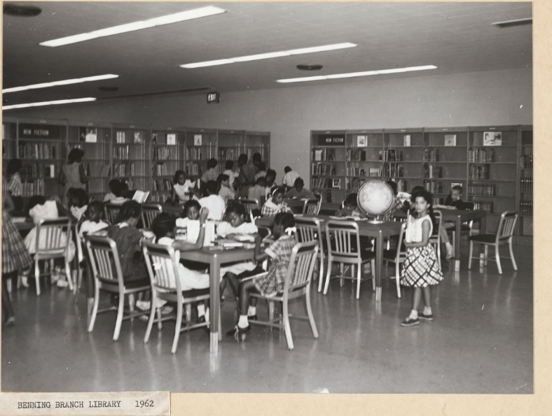
Researching at your Local Library
How to Use Library: Elementary, Lesson 9
Notes:
About this lesson
In this lesson, students will learn how to research in the library by asking a librarian for help and by searching the library catalog using its digital search tools. Students are instructed how to use the filters within the library's search to narrow search results. Students then demonstrate their understanding of the use of the search filters by searching using the "Audience" filters, "Children" and/or "Young Adult".
ELA Standards:
W.5.8: Recall relevant information from experiences or gather relevant information from print and digital sources; summarize or paraphrase information in notes and finished work, and provide a list of sources.
W.4.8: Recall relevant information from experiences or gather relevant information from print and digital sources; take notes and categorize information, and provide a list of sources.
W.3.8: Recall information from experiences or gather information from print and digital sources; take brief notes on sources and sort evidence into provided categories.
DC Content Power Standards:
3.4.5: Identify and research outstanding statements of moral and civic principles made in Washington, D.C., as well as the leaders who delivered them, that contributed to the struggle to extend equal rights to all Americans (e.g., Lincoln and his second inaugural address, Frederick Douglass and his speech against lynching at the Metropolitan AME Church, Martin Luther King Jr. and his speeches at the Lincoln Memorial in 1957 and 1963, and Rodolfo “Corky” Gonzales at the Poor People’s March).
4.7.7: Explain various reasons why people came to the colonies, including how both whites from Europe and blacks from Africa came to America as indentured servants who were released at the end of their indenture.
5.4.7: Students identify prominent people and movements for social justice in the United Stated including: Frederick Douglass, the Grimke sisters, and William Lloyd Garrison and the abolishment of slavery.
5.14.3: Identify key leaders in the struggle to extend equal rights to all Americans through the decades (e.g., Mary McLeod Bethune, Ella Jo Baker, César Chávez, Frederick Douglass, Rodolfo “Corky” Gonzales, Charles Houston, Martin Luther King Jr., Thurgood Marshall, Carlos Montes, Baker Motley, Rosa Parks, Malcolm X, Eleanor Roosevelt, and Reies López Tijerina).

Slide 2
Guiding Question
How do I use print materials to do research
at my local library?
Notes:
Teaching notes
Suggested Pacing: 1 minute
Directions:
Explain to students that in this lesson they will learn about how to find books, magazines, and other resources in their local library.

Slide 3
Introduction
How do I research in the library?
Notes:
Teaching notes
Suggested Pacing: 2 minutes
Directions:
Use an established classroom routine to pair students or move into small groups.
Turn and talk, "If you were going to the library to begin research on a specific topic, how would you start your search?"
Allow students to discuss, then call on groups or individuals to share.
Tell students that there are two main ways to start their research in a library. They can ask the librarian or they can use the library computers to search the library catalog.
Explain that the library catalog is the collection of magazines and texts that are housed inside a library.
Attribution:
Children at Benning Branch Library, DC Public Library Archives

Slide 4
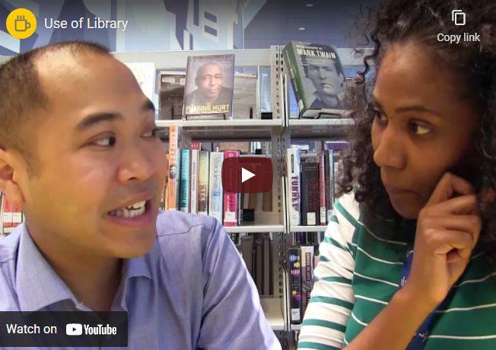
Ask a Librarian
Notes:
Teaching notes
Suggested Pacing: 2 minutes
Directions:
Play the video to remind students that librarians are in all libraries to help them find what they might need.
Click "View the original page" at the bottom of the slide to view the video in full screen.
If needed, model how to ask about certain topics for students.
Student Look-Fors:
Students recognize that they can ask a librarian for help to get started on research in the library.
Attribution:
Use of the Library

Slide 5
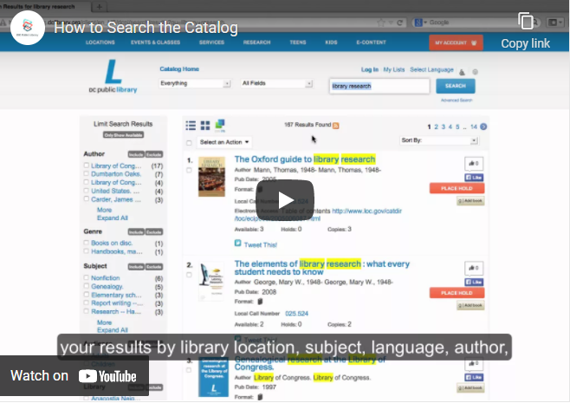
Search the Catalog
Notes:
Teaching notes
Suggested Pacing: 4 minutes
Directions:
Say, "In order to find the most relevant sources at the library, you will need to use the online catalog to locate books and other materials for your research. Let's watch to see how it works!"
Play the video to show students how to utilize the library catalog to find a book or magazine.
Click "View the original page" at the bottom of the slide to view the video in full screen.
If needed, replay and/or model to demonstrate the process for different topics.
Make sure to point out the call number and explain that this is the number students can use to locate a book within the library.
Student Look-Fors:
Students understand how to locate texts using the library catalog.
Students recognize that the call number is used to locate a book within a library.
Attribution:
How to Search the Catalog

Slide 6
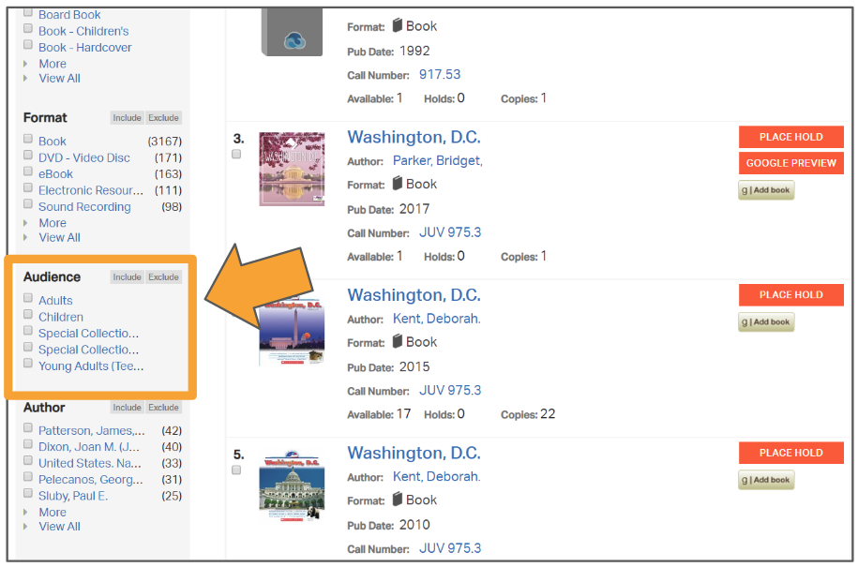
Filter by Audience
Notes:
Teaching notes
Suggested Pacing: 1 minute
Directions:
Explain that because the DC Public Library has so many resources for students, their search may generate many results. To help narrow down their search, students can choose filters. In this case, the chosen filter is by "Audience."
This means that students can select only books written for children or young adults to make sure they find books at an appropriate reading and interest level.
To filter by audience, tell students to scroll down through their search results until they see "Audience" in the left sidebar. Then they can check the box for "Children" and click "Include".
There is a video on the following slide demonstrating this.
Student Look-Fors:
Students understand how to locate texts using the library catalog filter, "Audience."

Slide 7
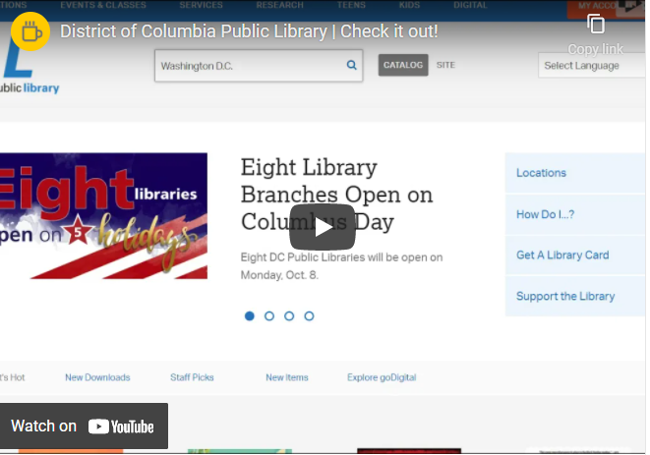
Filter by Audience
Notes:
Teaching notes
Suggested Pacing: 1 minute
Directions:
If needed, play video to demonstrate filtering search results by "Audience."
Click "View the original page" at the bottom of the slide to view the video in full screen.
Student Look-Fors:
Students understand how to locate texts using the library catalog filter, "Audience."
Attribution:
District of Columbia Public Library | Check it out!

Slide 8
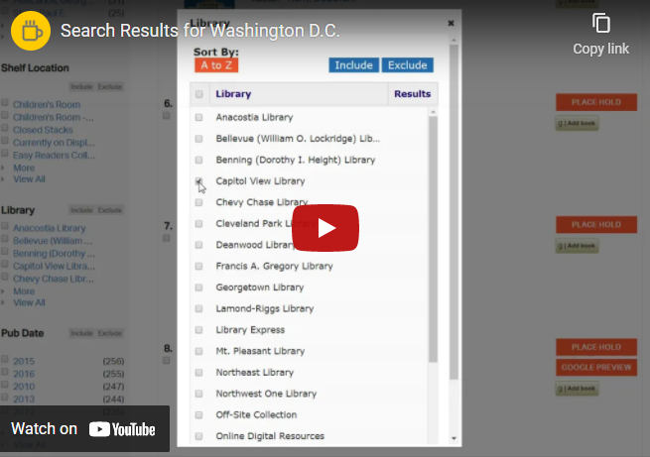
Filter by Location
Notes:
Teaching notes
Suggested Pacing: 1 minute
Directions:
Explain that another useful way to filter results is by location to only see books that are located at a specific library building.
Watch the video modeling how to filter results by location and answer any questions students may have.
Note that there are many filters in the sidebar that students can use to help them find resources, including "Material Type" and "Format".
If needed, look up which DC Public Library facility is closest for students to use.
Student Look-Fors:
Students understand how to locate texts using the library catalog filter for a specific library branch.
Attribution:
Search Results for Washington D.C.

Slide 9
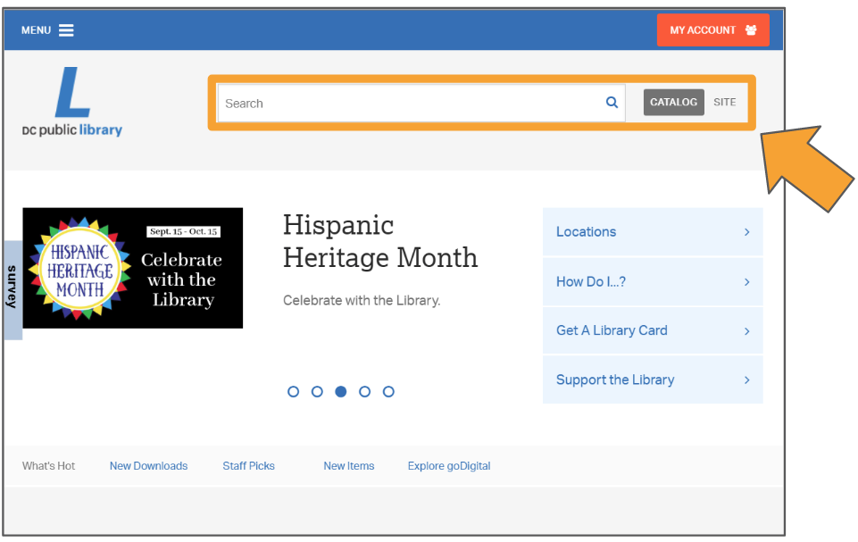
Express Your Understanding
What else can I learn by searching the keyword Frederick Douglass?
Notes:
Teaching notes
Suggested Pacing: 8 minutes
Directions:
Distribute devices to students. If there are not enough devices for each student, then students may share in small groups.
Explain that today students will continue to research Frederick Douglass.
Distribute an index card to each student.
Have each student navigate to the DCPL homepage at www.dclibrary.org.
Tell students that they will use the search feature to search the library online catalog for at least three sources to be used in their research on Fredrick Douglass.
Instruct students to use the left sidebar to narrow their search results with the Audience filters, "Children" or "Young Adult".
Students will record the title of each text as well as the call number of each source on the index card.
Collect completed index cards as a formative assessment.
Student Look-Fors:
Students record 2-3 titles and call numbers for texts related to Frederick Douglass.
Students use the search Audience filter "Children" or "Young Adult" to narrow search results.
Attribution:
"DC Public Library." Accessed Sept. 27, 2018.

